Slide 1
CIS 5525: Neural Computation
Week III: Recurrent Neural Networks
Instructor: Kai Zhang
CIS @ Temple University, Spring 2020

Slide 2
Feature engineering – Gobbler filter =/= kernels in CNN – feature engineering.
Feature extraction (in CNN)
Classification – downstream learning task

Slide 3
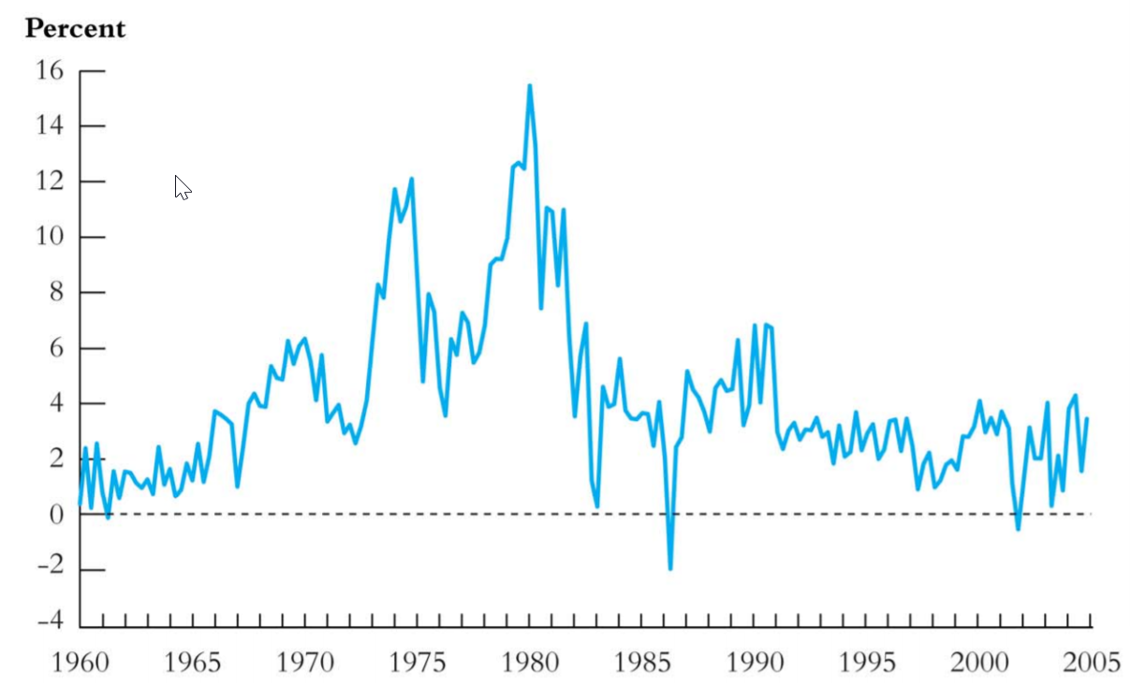

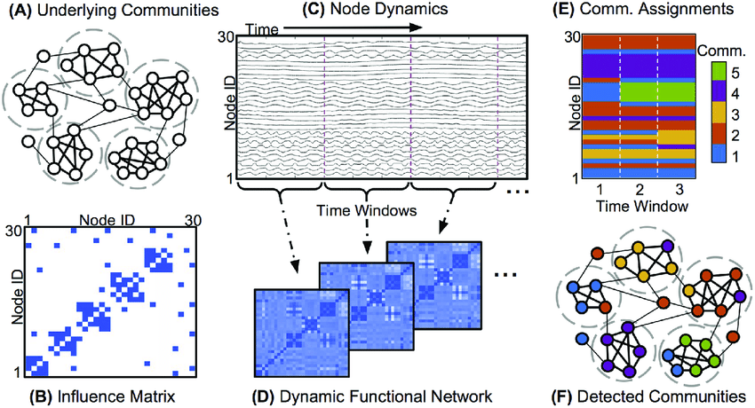
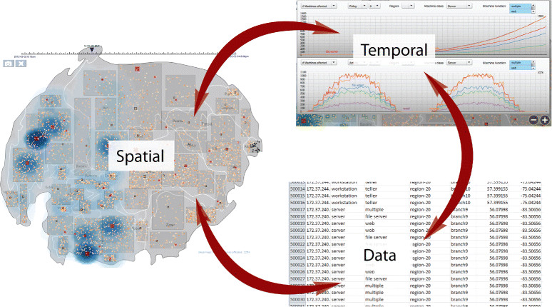
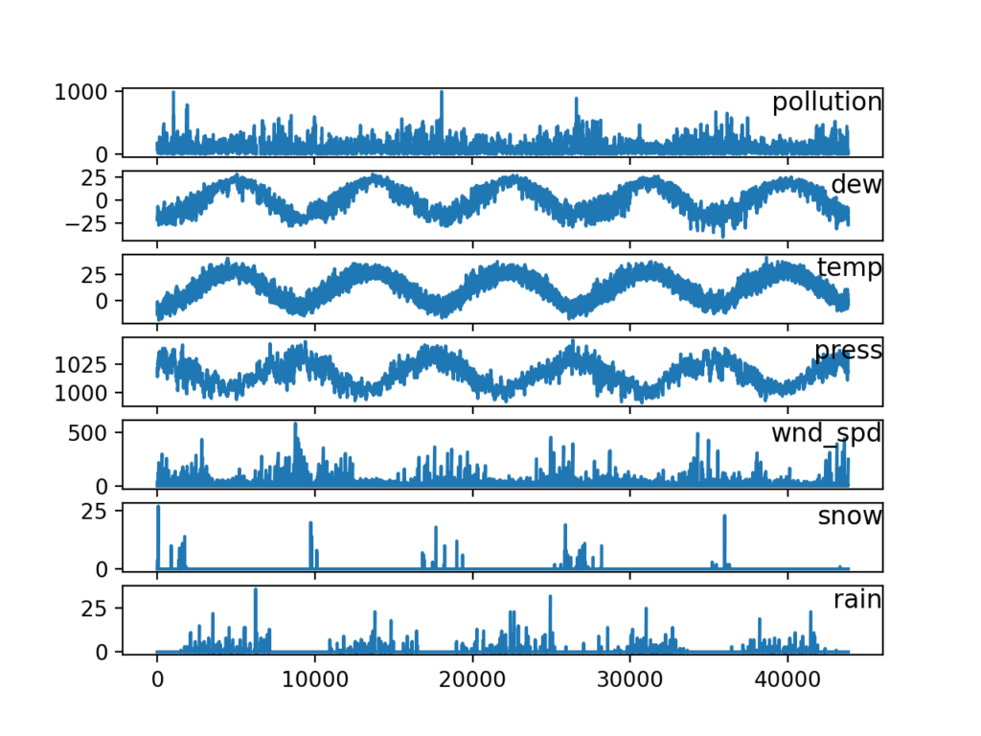
Sequential /Time-series data
US rate of price inflation

Slide 4
Key Elements
A time series is a sequence of information that attaches a time period to each value.
Time period: duration of the data
Frequency: how often the values of the data set are recorded
patterns: we can expect the patterns we observe in time-series to persist in the future.
What are the tasks associated with time series?
Prediction
Clustering or classification
Anomaly detection
Visualization
…

Slide 5
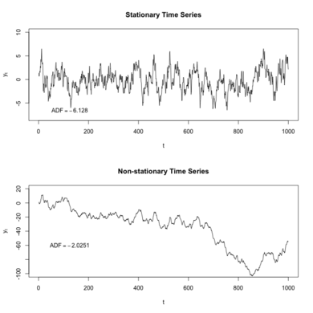
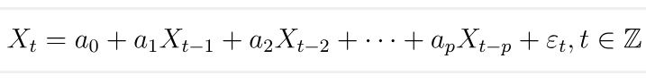
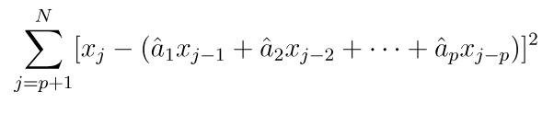
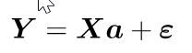
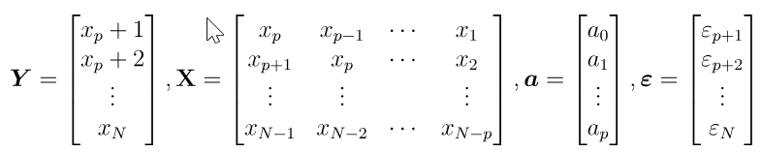
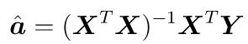
ARMA model
Auto-regression(AR) model
Popular model for stationary time series (stationarity means that the statistical properties of a process generating a time series do not change over time.)
P-order auto-regressive model
Let {ε_{t}} be white Gaussian noise N(0,σ²)，a₀,a₁,...,a_{p}(a_{p}≠0) are coefficients
Can be solved easily using least square regression, by minimizing the residual
In matrix form, we have
Closed-form solution

Slide 6
ARMA Model
What are the limitations?
Linear dependency assumption
Can be relaxed to polynomials, or even kernel regression
Prediction at time t only depends on a window
Can we include more temporal points without increasing the model size?
time

Slide 7
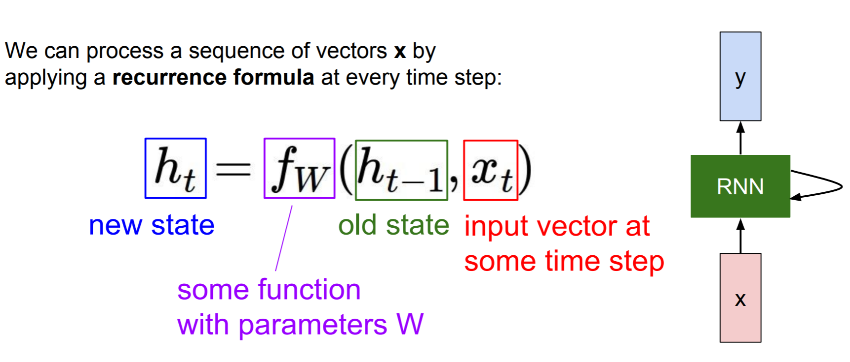
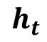
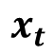
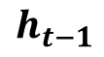
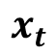
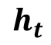
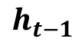
Recurrent Neural Networks
$$h_{t}$$
$$h_{t−1}$$
$$x_{t}$$
$$h_{t}$$
$$h_{t−1}$$
$$x_{t}$$
time
t

Slide 8
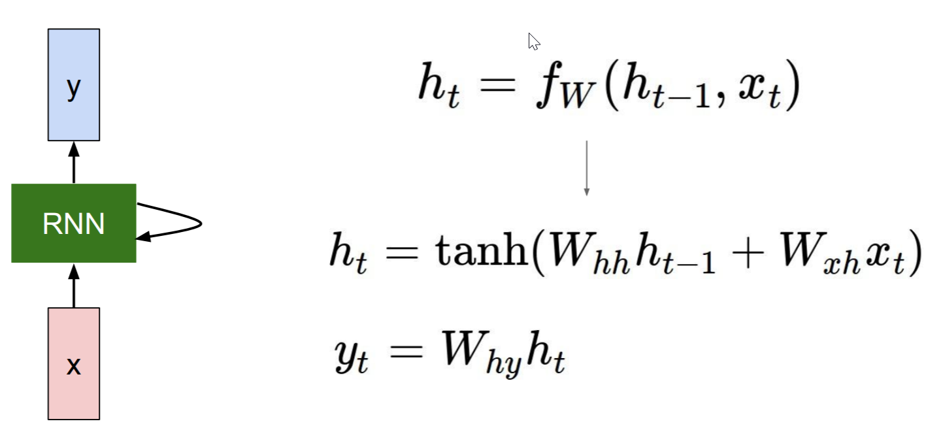
Vanilla RNN

Slide 9
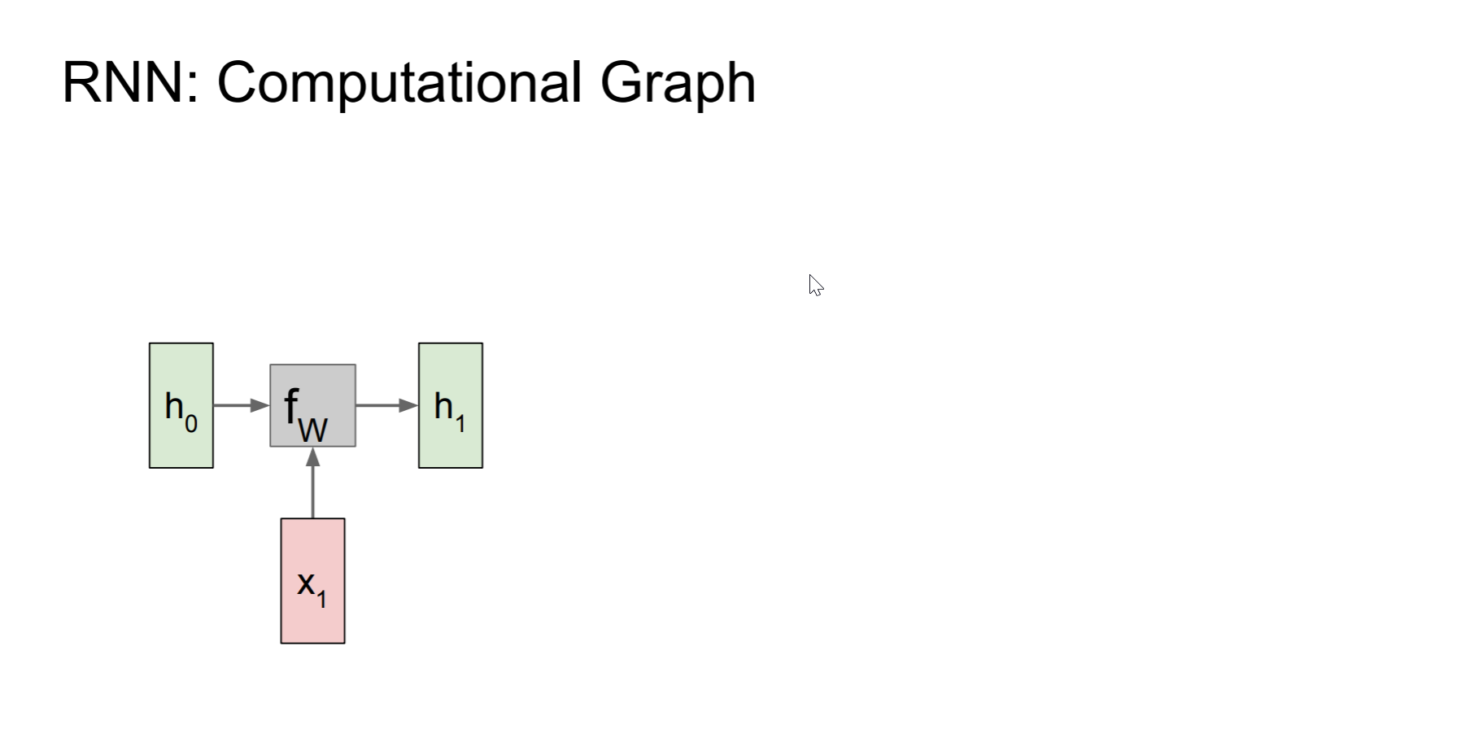
Computational Graph

Slide 10
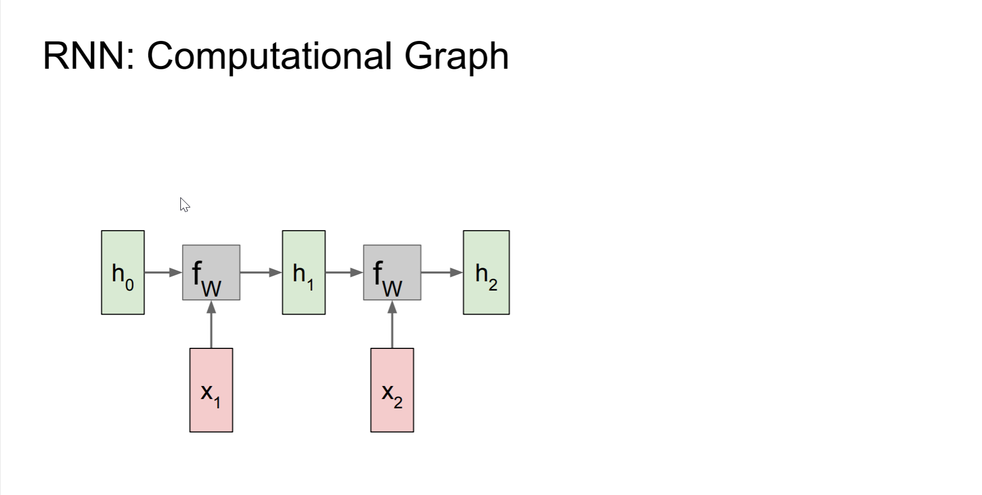
Computational Graph

Slide 11
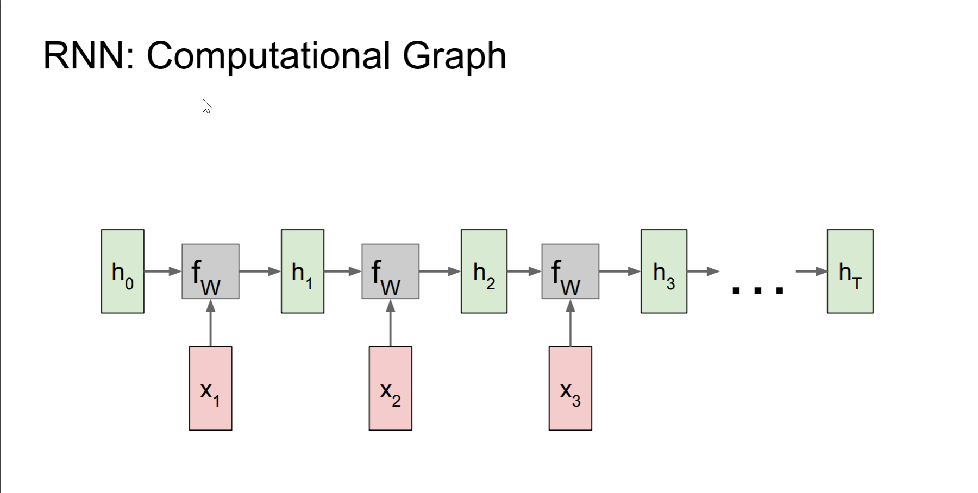
Computational Graph

Slide 12
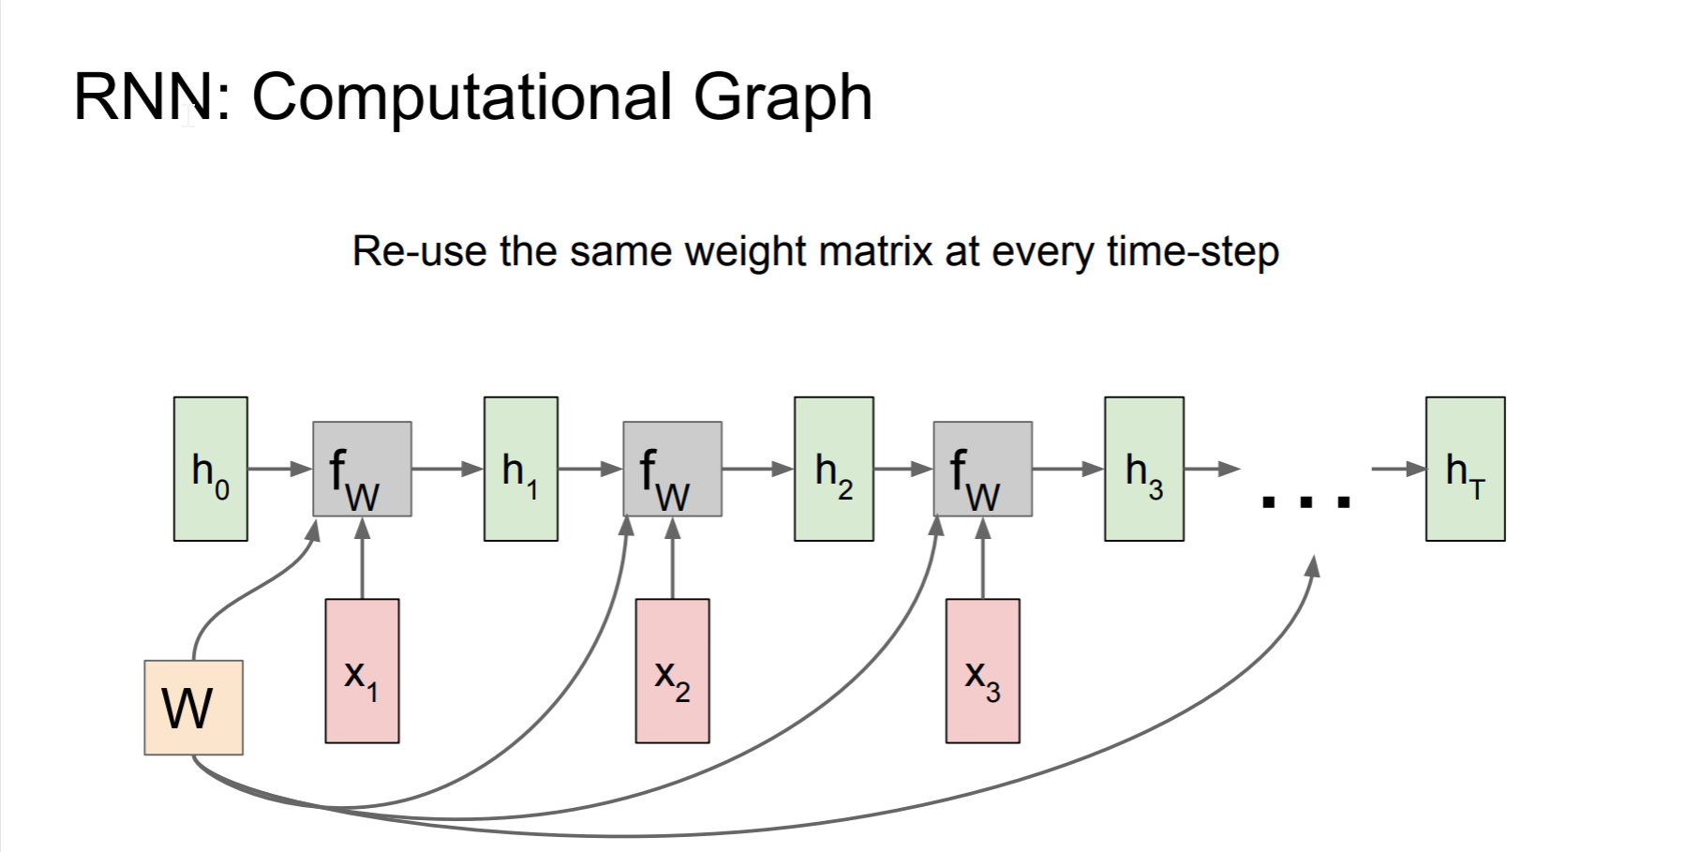
W/ Teaching Forcing

Slide 13
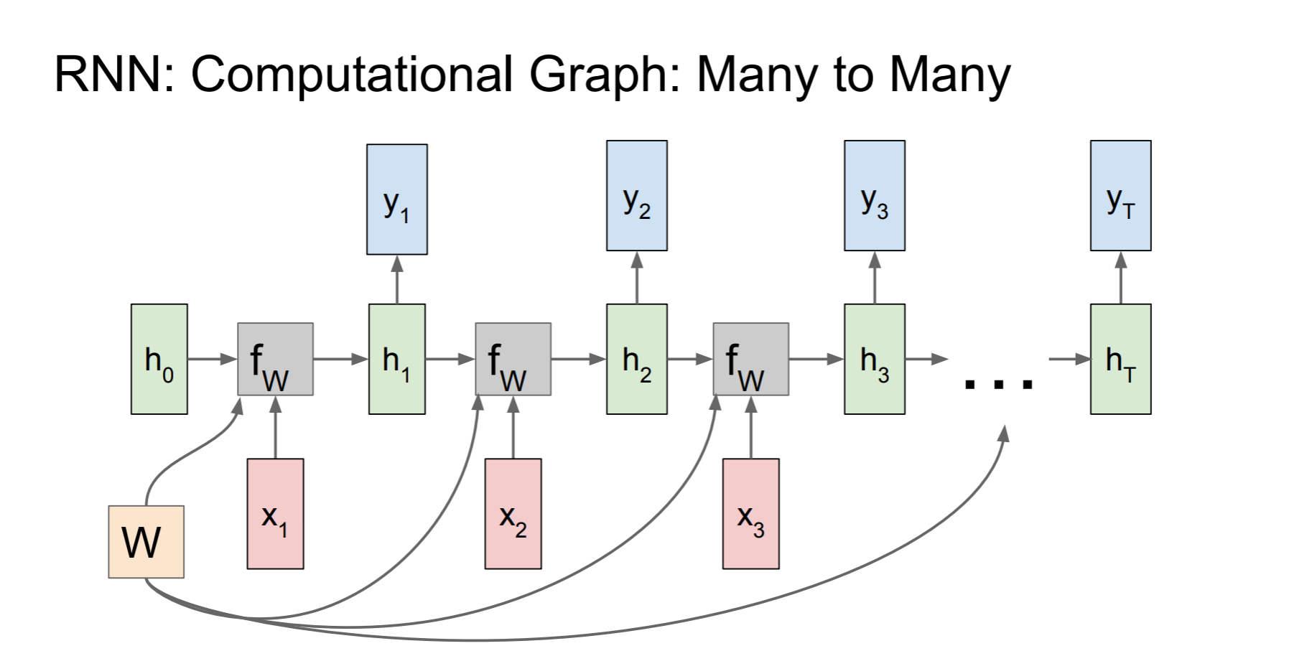

Slide 14
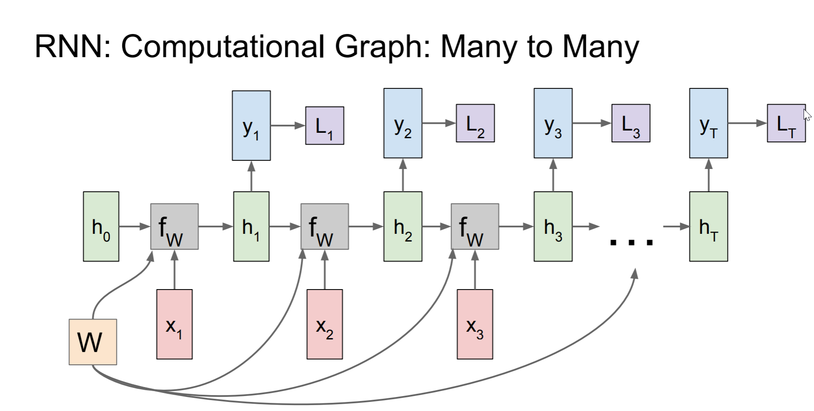

Slide 15
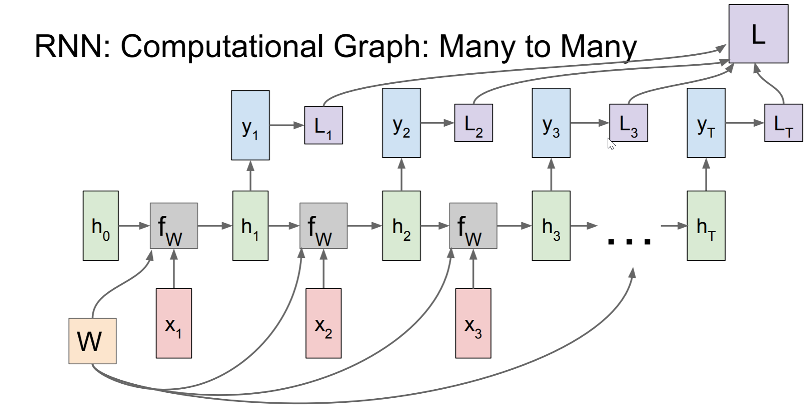

Slide 16
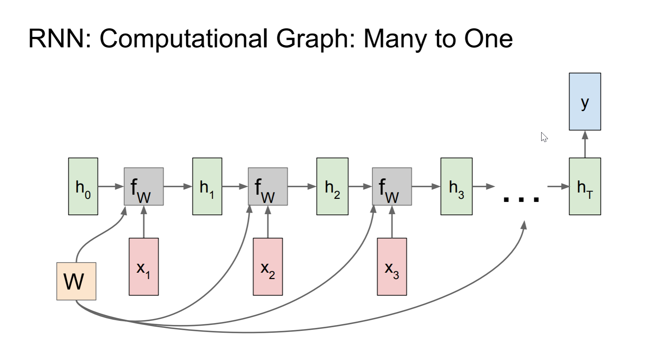

Slide 17
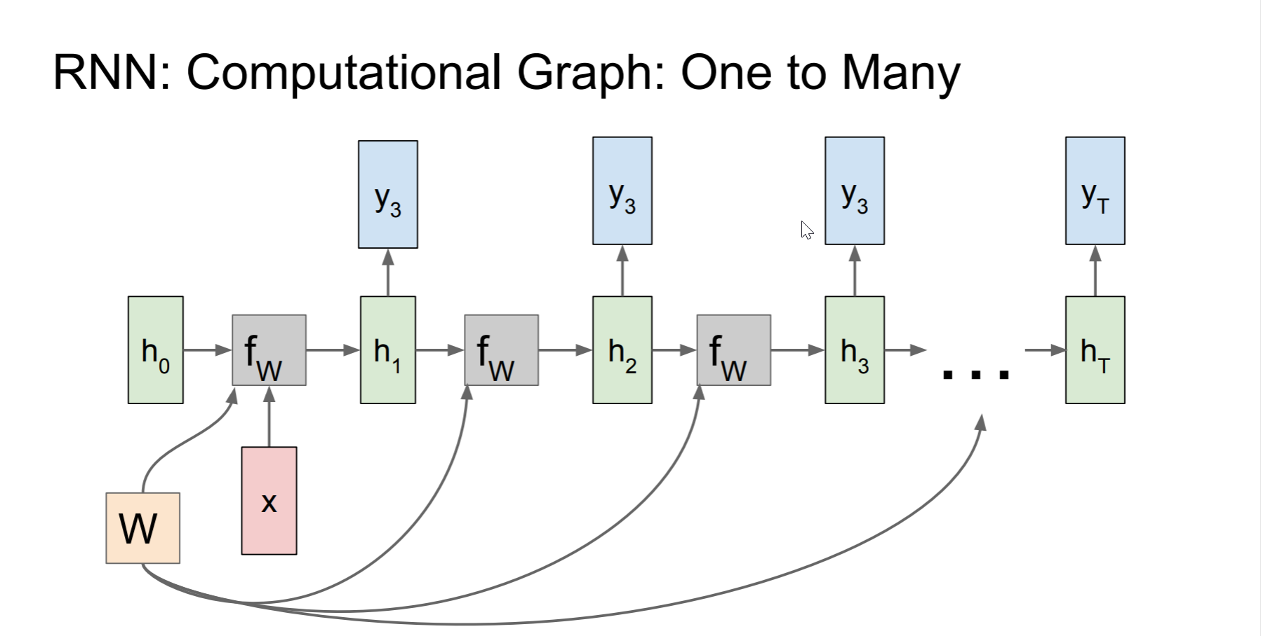

Slide 18
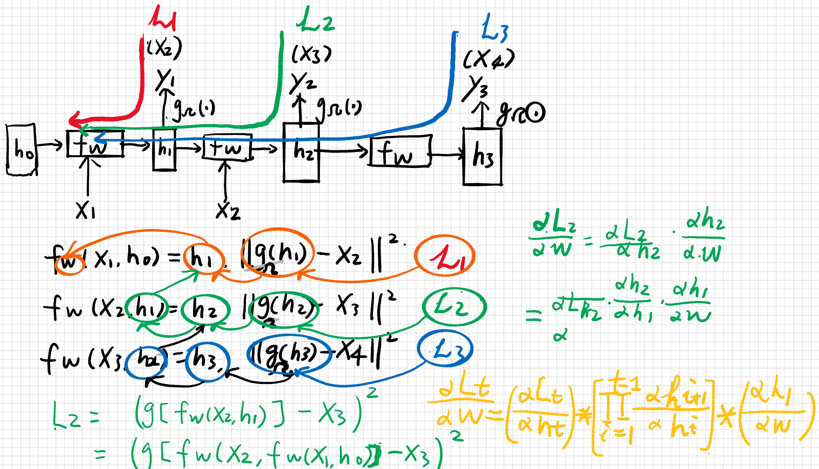
Backpropagation through time
(BPTT)
X3
multiplicative terms here has a norm that will either diminish or explode with large t

Slide 19
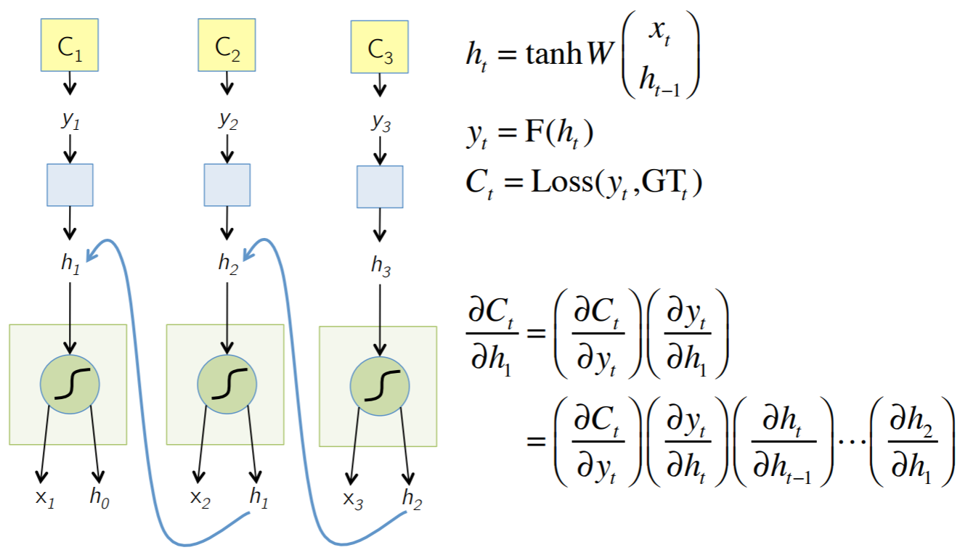
Illustration
L1
L2
L3

Slide 20
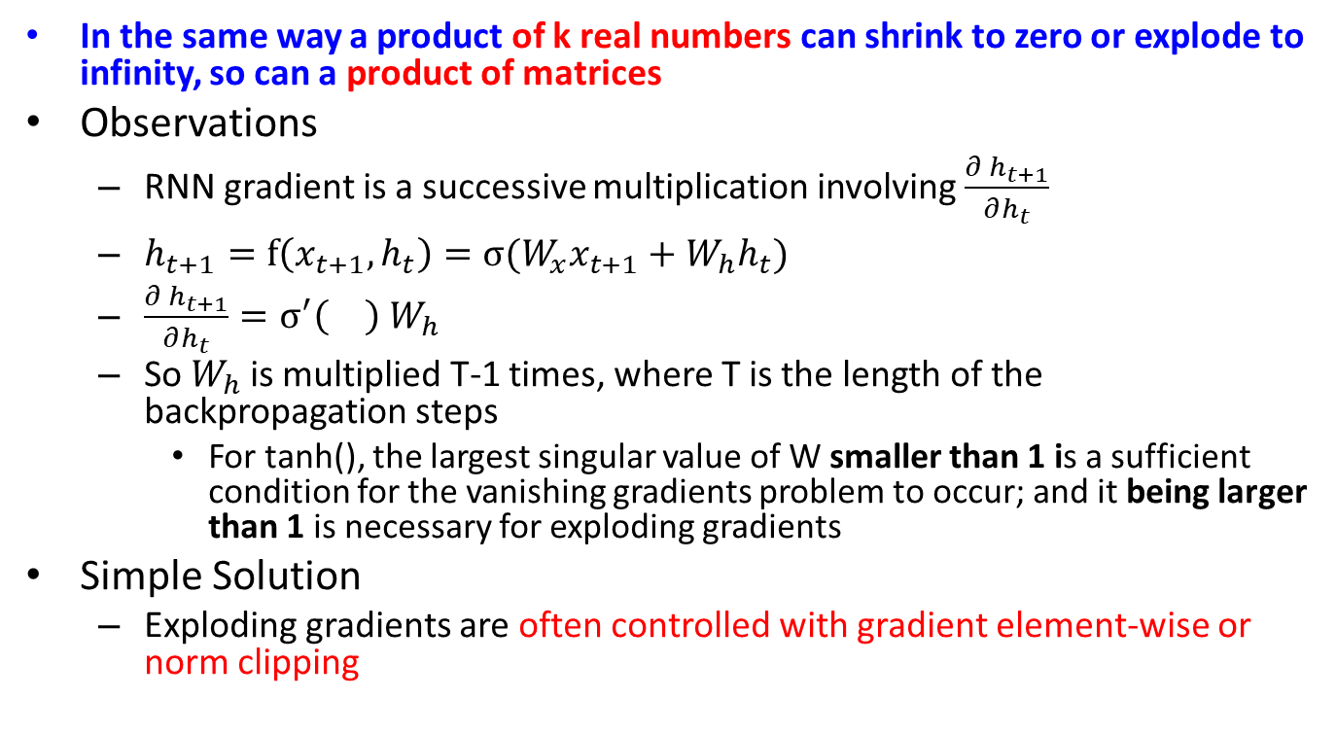
Vanishing/Exploding Gradient
In the same way a product of k real numbers can shrink to zero or explode to infinity, so can a product of matrices
Observations
RNN gradient is a successive multiplication involving $\frac{∂ h_{t+1}}{∂h_{t}}$
$h_{t+1}=f\left(x_{t+1},h_{t}\right)=σ(W_{x}x_{t+1}+W_{h}h_{t})$
$\frac{∂ h_{t+1}}{∂h_{t}}=σ^{′}\left(\right)$ $W_{h}$
So $W_{h}$is multiplied T-1 times, where T is the length of the backpropagation steps
For tanh(), the largest singular value of W smaller than 1 is a sufficient condition for the vanishing gradients problem to occur; and it being larger than 1 is necessary for exploding gradients
Simple Solution
Exploding gradients are often controlled with gradient element-wise or norm clipping
Reference: On the difficulty of training recurrent neural networks, Pascanu et al., 2013

Slide 21
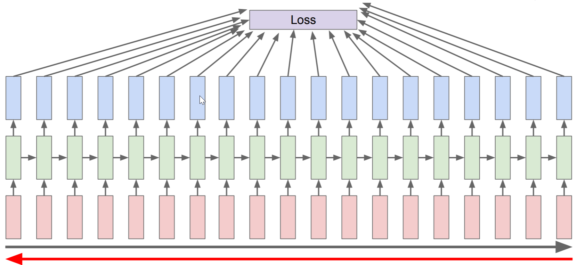
Backpropagation in Time
Forward through entire sequence to compute loss, then backward through entire sequence to compute gradient

Slide 22
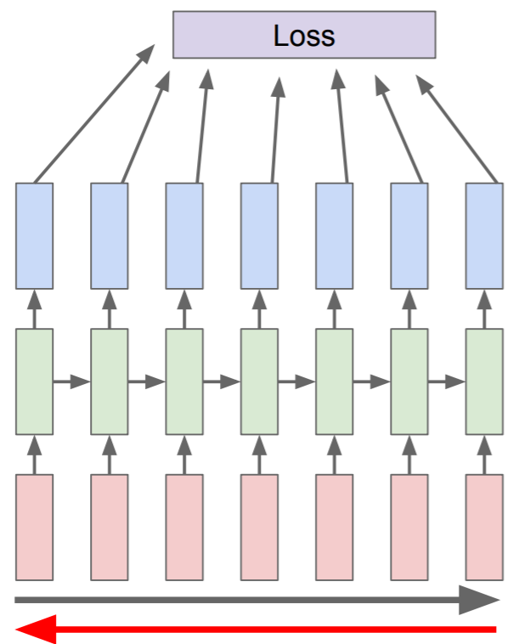
Truncated BPPT
Run forward and backward through chunks of the sequence instead of whole sequence

Slide 23
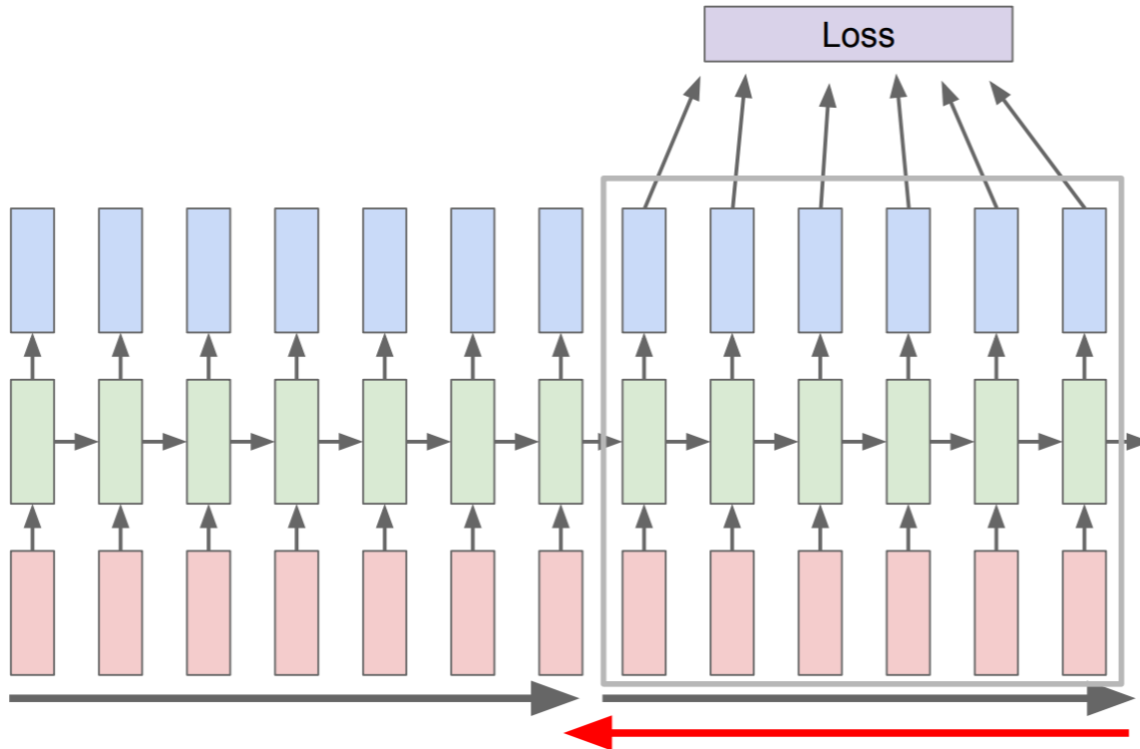
Carry hidden states forward in time forever, but only backpropagate for some smaller number of steps

Slide 24
Pros and Cons of Vanilla RNN
Cons
Can handle data sequence of arbitrary length.
Distributed hidden state that allows them to store a lot of information about the past efficiently.
Non-linear dynamics that allows them to update their hidden state in complicated ways.
No need to infer hidden state, pure deterministic. 4. Weight sharing
Pros
Have to compute sequentially
Can we parallel the training of RNNs?
The gradient explodes/decays exponentially with time, making training using 1st-order optimization methods challenging
Only makes forward inference, no backwards looking inference or interpolation
Can quickly forget useful historical data
What is the main bottleneck for RNN that is forgetful?
How to resolve it?

Slide 25
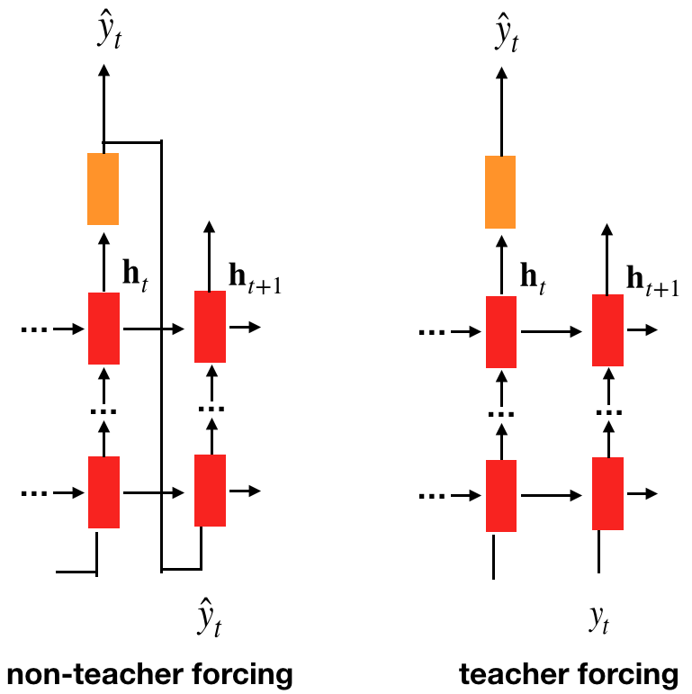
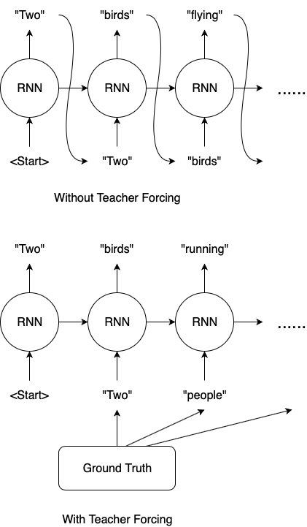
Teaching Forcing
Practical RNN Setting for time series prediction
E.g., predicting load demand in the next multiple (T) hours

Slide 26
Teaching Forcing
Advantage of teaching forcing
In comparing loss function to output all time steps are decoupled
Training can be parallelized
Gradient for each step t computed in isolation
No need to compute output for the previous step first, because training set provides ideal value of output
Disadvantages of teaching forcing
Predicting one time step ahead is usually not useful, cannot capture the long term trend
Training phase and testing phase become different
When predicting multiple time steps
Error accumulation over time

Slide 27
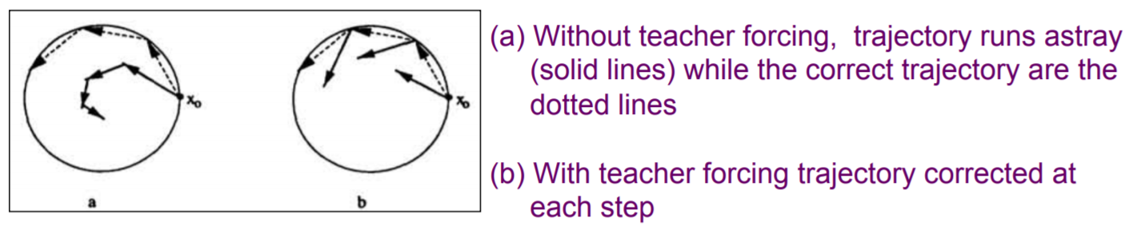
Error Accumulation
Imagine that the network is learning to follow a trajectory
Without teacher forcing, it goes astray (because the weights are wrong)
Qith teacher forcing puts the net back on its trajectory
By setting the state of all the units to that of teacher’s.

Slide 28
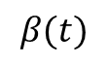
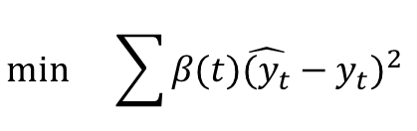
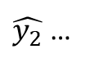
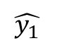
RNN without Step-wise Teaching Forcing
Training period
????????
test
Limited Teaching Forcing Signal
Want to predict multiple time steps
Practical setting
How to generate training-test pairs?
Partition the data into training-testing segment pairs
How to teach the model to predict better when fed with inaccurate (self-predicted, previous step) signal?
In training phase, feed self-predicted sigal
Apply decreasing penalty strength on more future predictions
X
Y
X
Y
????????
test
$$β(t)$$
$$\min{}\sum{β(t)\hat{(y_{t}}−y_{t})^{2} }$$
$$\hat{y_{1}}$$
$\hat{y_{2}}$ …

Slide 29
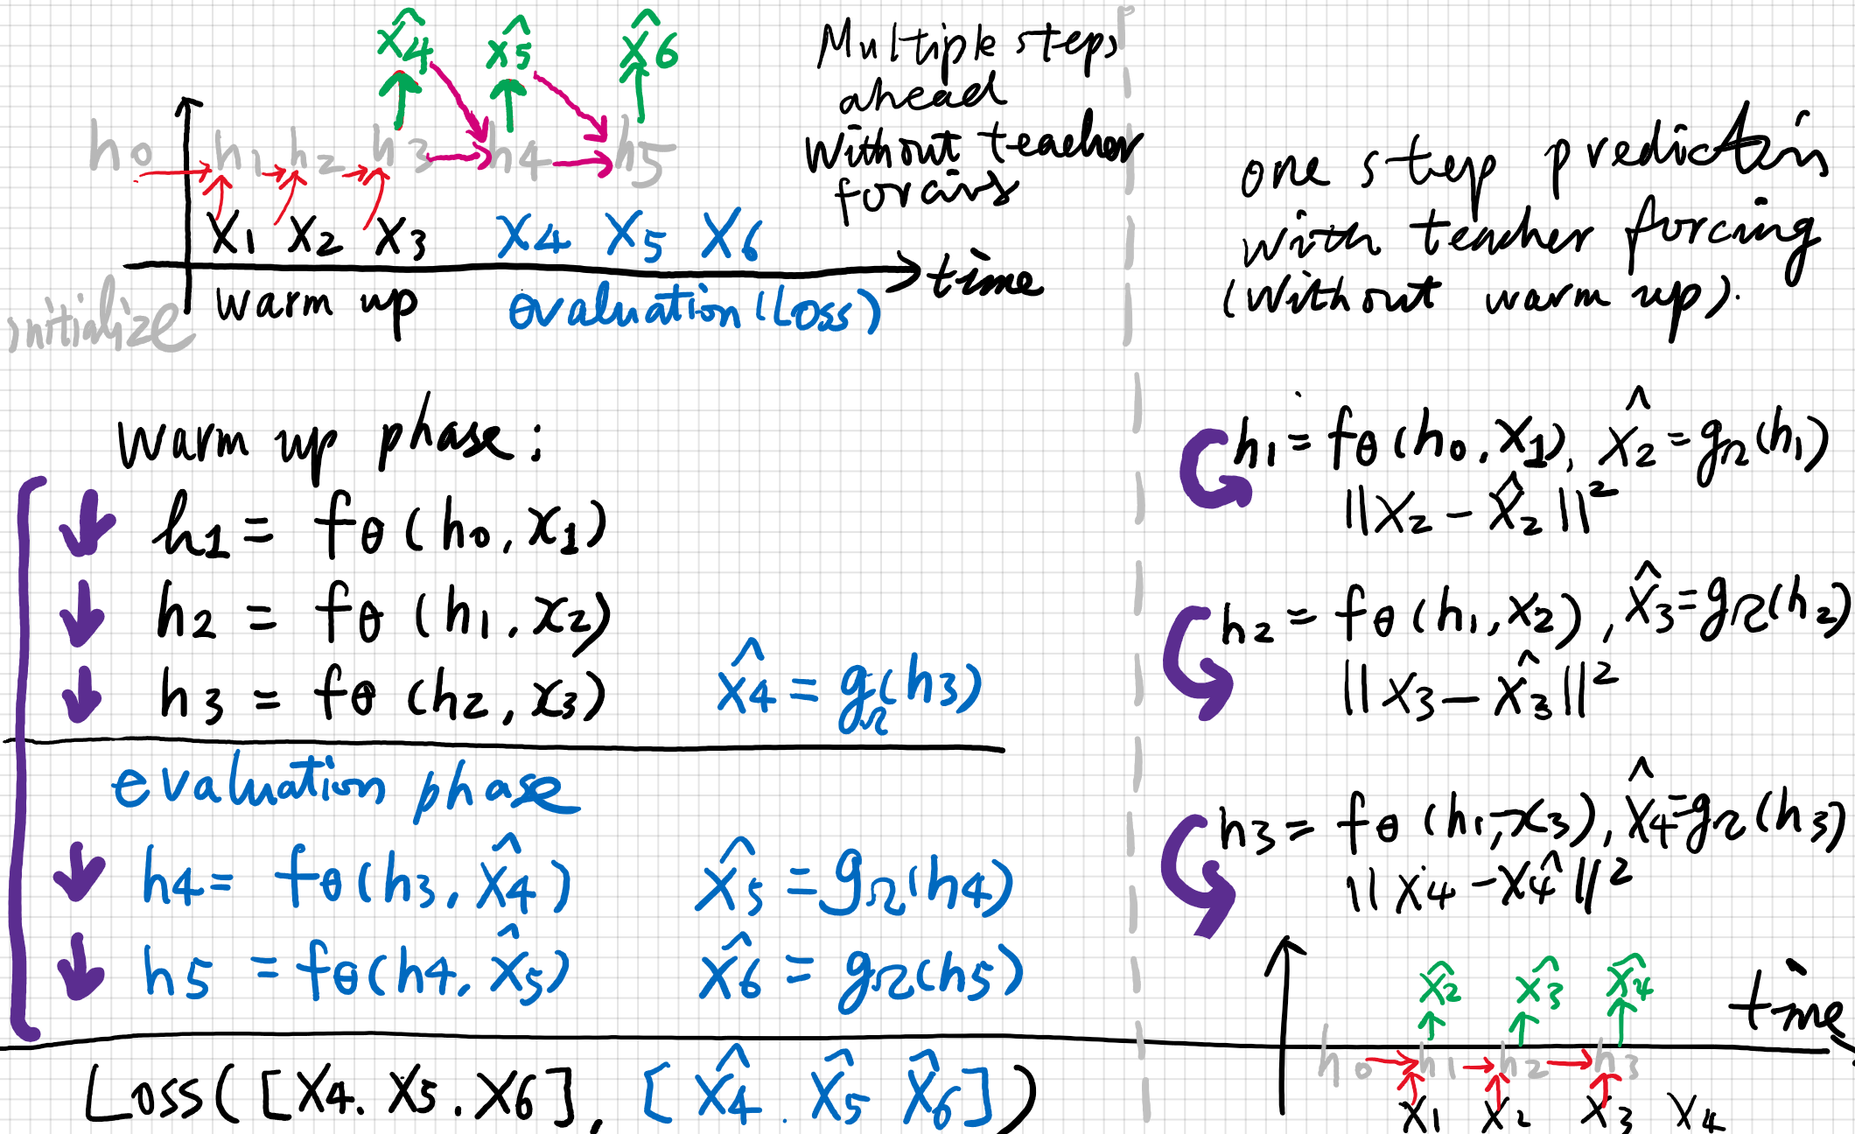
Warmup in RNN

Slide 30
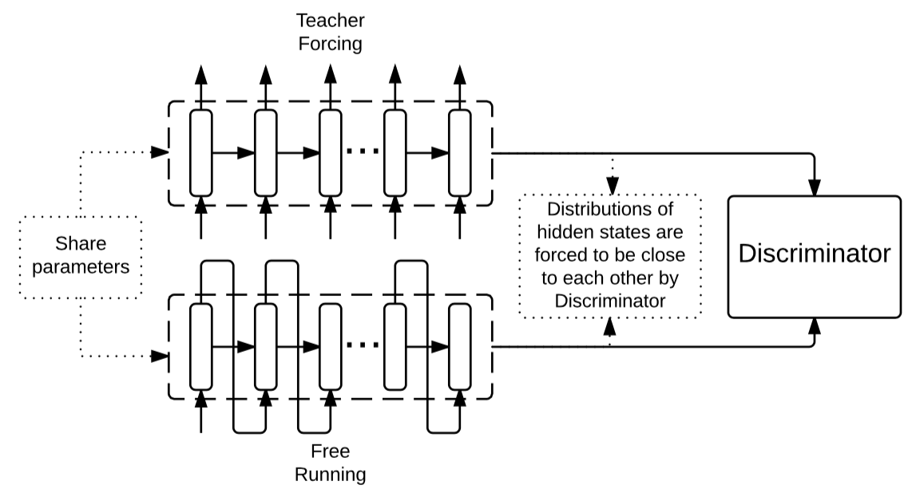
Combine Teacher/No-teacher Forcing
Parallel sessions of teacher forcing and no-teacher forcing
Also called professor forcing

Slide 31
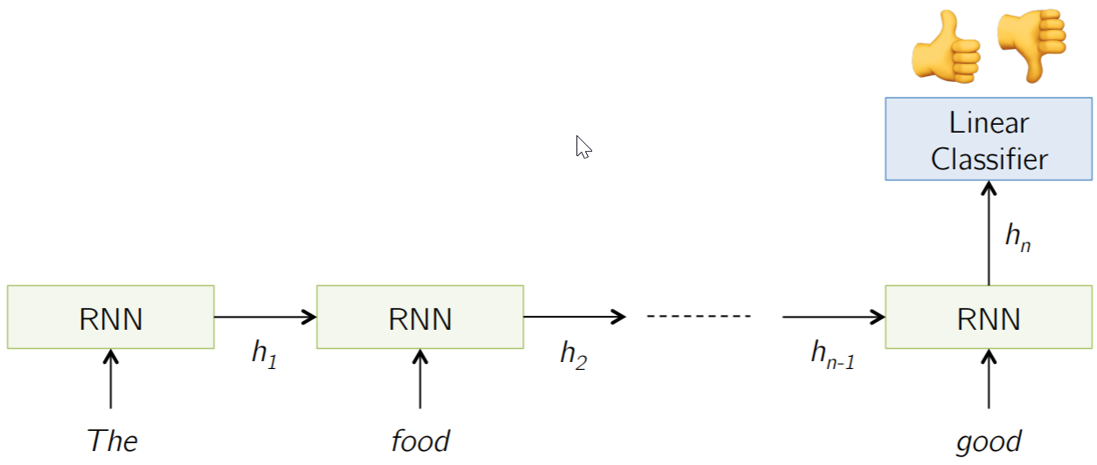
Applications
Sentiment classification: Classify a restaurant review from Yelp! OR movie review from IMDB OR … as positive or negative
Inputs: Multiple words, one or more sentences
Outputs: Positive / Negative classification
Example: “The food was really good”

Slide 32
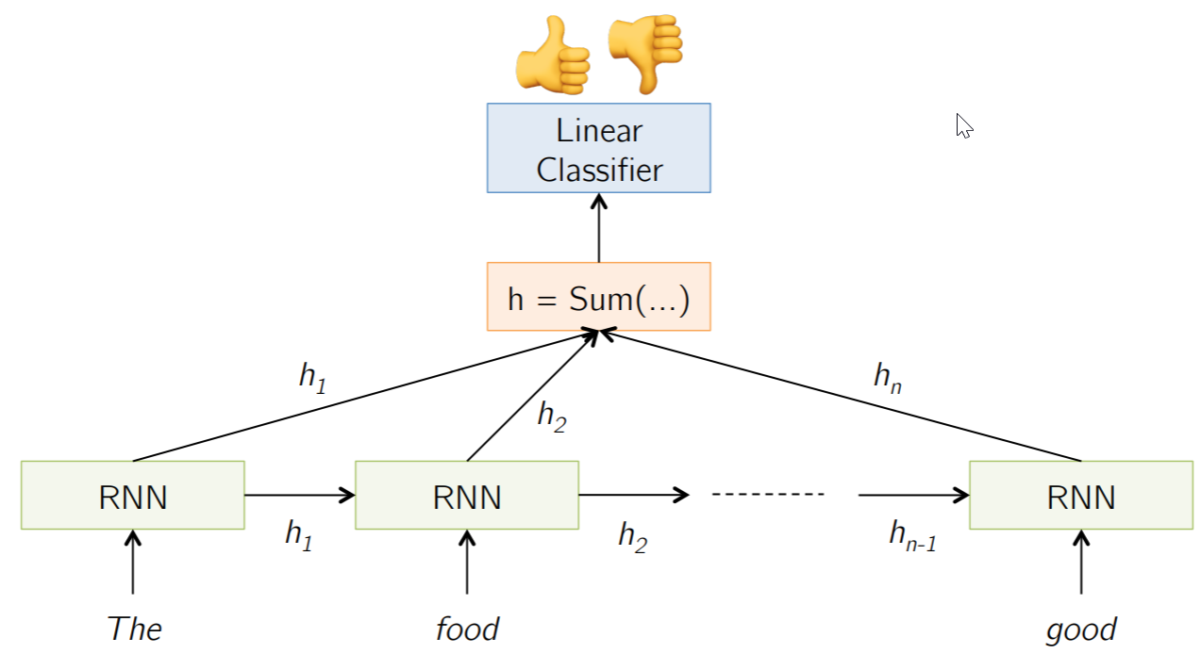
Sentiment Classification

Slide 33
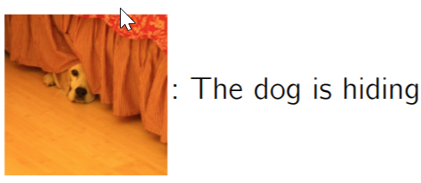
Image Captioning
Given an image, produce a sentence describing its contents
Inputs: Image feature (from a CNN)
Outputs: Multiple words (let’s consider one sentence)

Slide 34
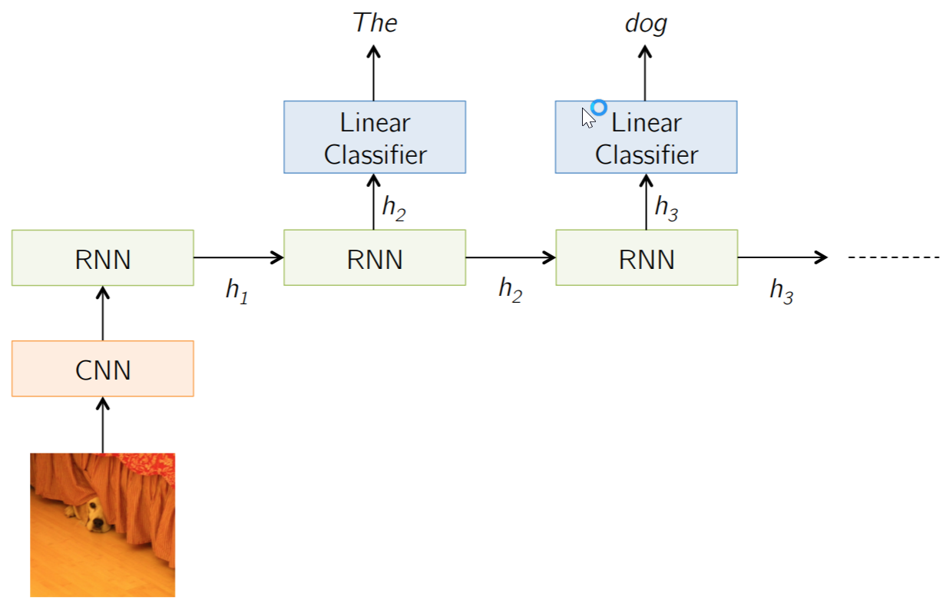
Image captioning

Slide 35
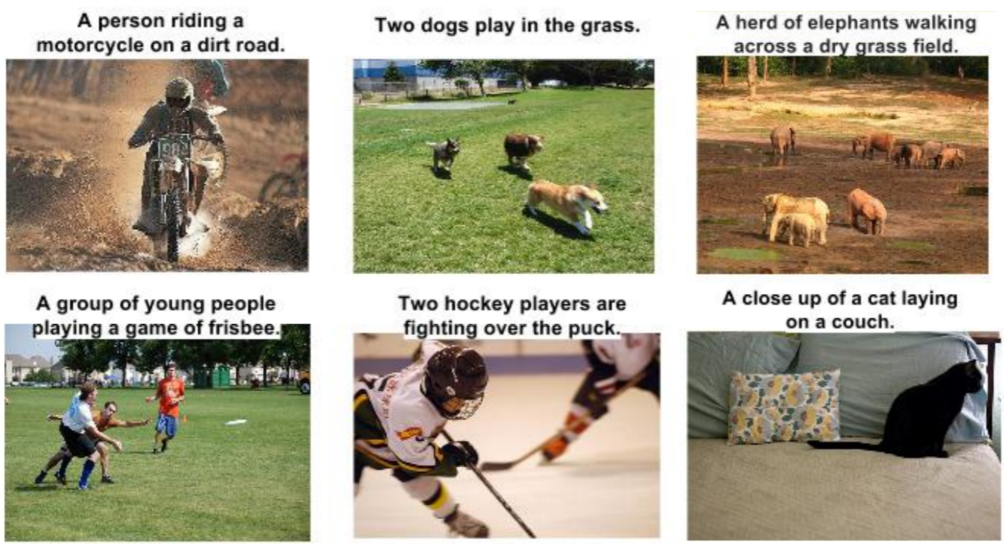
Image captions

Slide 36
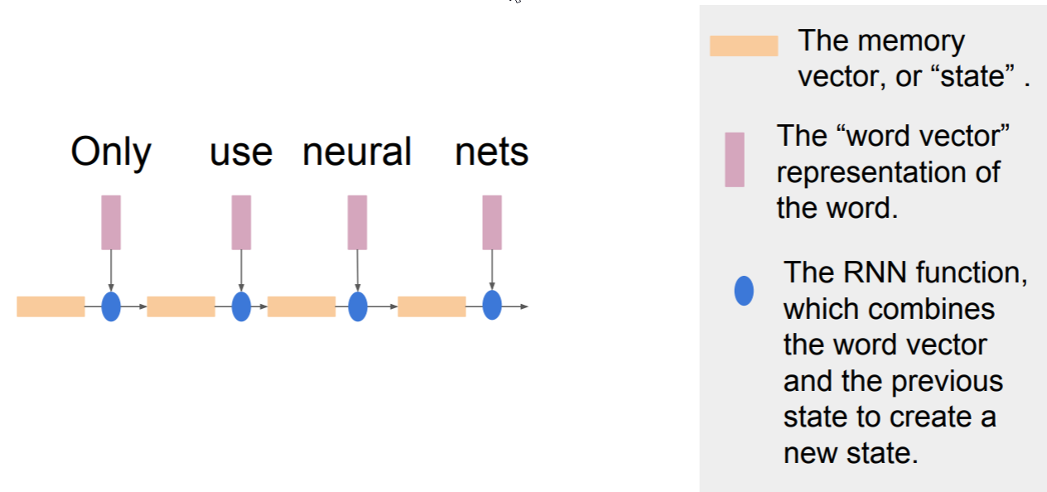
Neural Translation
Sequence to sequence models (encoder-decoder)
First, RNN for language modelling （encoder）
The method of building the representation is called an Encoder and is frequently an RNN
Each memory vector in the encoder attempts to represent the sentence so far, but mostly represents the word most recently input.

Slide 37
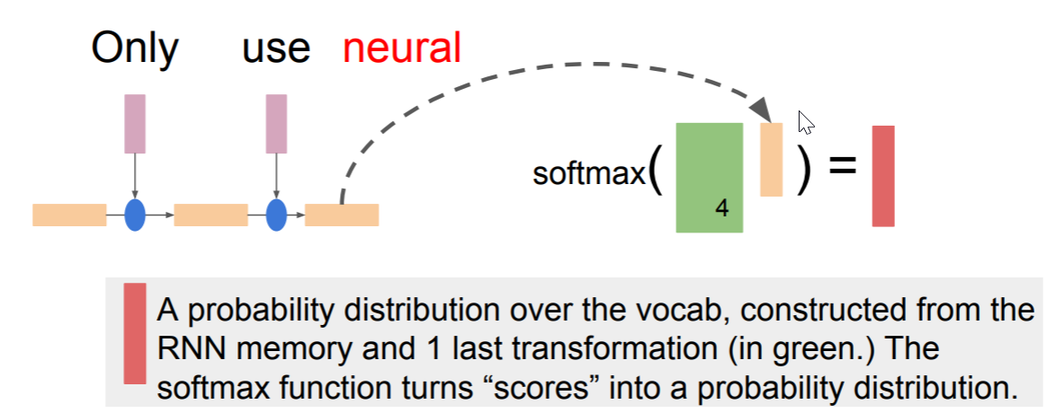
Prediction part

Slide 38
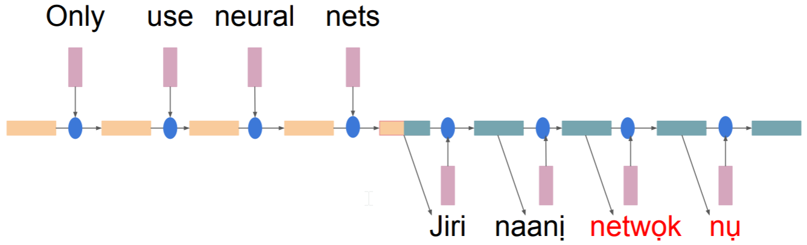
Decoder: The model that takes the encoded representation and generates the output is called the Decoder, and, errrr, is also generally an RNN
generate the output one token at a time

Slide 39

Seq2seq Structure

Slide 40

How to train Seq2seq
“forcing” the decoder to generate gold sequences, and penalizing it for assigning the sequence a low probability.
Losses for each token in the sequence are summed.
Then, the summed loss is used to take a step in the right direction in all model parameters (including word embeddings!) (stochastic gradient descent.)

Slide 41


How to define the loss
For prediction, we take the current hidden state, and use it as features in what is more or less a linear regression.
Let d_{t} be our decision (e.g., word, POS tag) at timestep t. Let D be the set of all possible decisions. Let s_{t-1} be the most recent decoder hidden state.

Slide 42

Input – Output Scenarios

Slide 43



Long-short term Memory
Long Short-Term Memory (LSTM) networks are RNNs capable of learning long-term dependencies [Hochreiter and Schmidhuber, 1997]
A memory cell using logistic and linear units with multiplicative interactions:
make additive connections between time steps
Addition does not modify the gradient, no vanishing
Gates to control the information flow
Information gets into the cell whenever its input gate is on.
Information is thrown away from the cell whenever its forget gate is off.
Information can be read from the cell by turning on its output gate.

Slide 44


o
o

